Slide 1
The Solvency Framework Review
Emile Stipp
Discovery Health

Slide 2
Background of solvency framework review
Current Solvency Framework
Pros
Easy to understand
Simple to calculate
Cons
High reserves inefficient and costly
Schemes pricing for deficits hold lower reserves
No account for actual risk of scheme
Review of current solvency framework by CMS
CMS published a proposed RBC framework
ITAP has also developed an RBC framework

Slide 3
Objective of ITAP’s RBC framework
ITAP developed an internal model for use by CMS to prospectively identify medical schemes at high risk of failure
  This will allow CMS to intervene timeously
  Highlight schemes for further investigation
This should be expanded to a full RBC framework

Slide 4
Main risks facing a scheme
Liability
Operational
Asset

Slide 5
Features of the ITAP and CMS models
Both the CMS and ITAP models account for major risks and express risk as a percentage of contributions
However, the models differ in the following ways:
Time horizon
ITAP – 1 year
CMS – 3 year business risk, 1 year asset risk
Prob. of loss
1 in 200 years
1 in 100 over 3 years
Model Features
ITAP – simpler, objective, based on available data
CMS – more complex, subjective areas, certain data unavailable

Slide 6
Liability risk – ITAP proposal
  Liquidity risk
    Schemes need to hold capital to fund claims and expenses in the months where contributions are insufficient to cover this
    Months with high seasonality
  Claims volatility risk
    Formula based on scheme size
  Pricing risk
    Use operating result of last 3 years
    More weight for more recent years

Slide 7

Liability risk – CMS proposal
CMS proposes a stochastic model with 3 year time horizon
Model projects future cashflows of a scheme on a monthly basis to calculate the probability of ruin
Assumptions are required for all variables on income statement
?
Costly, time consuming and complex
?
No IBNR or catastrophic component (also applies to ITAP model)
?
Parameterization at an industry level difficult
?
Double counts the asset risk

Slide 8
Assessment of CMS liability risk model
Business risk of DH administered schemes as calculated using CMS stochastic model
Business risk capital required (% of risk contributions)
Would expect a decreasing solvency requirement with increasing scheme size, however this relationship is not observed when using the CMS model

Slide 9
Operational risk – ITAP proposal
Bad debts
  Use prior year net impairment losses, trade and other receivables
Expense risk
  Risk exists where scheme winds down
  Claims can still be submitted 4 months after treatment
  Propose holding 2.5 months of expenses
Default by third parties
  Third parties not required to hold capital
  If third party defaults, scheme is liable to settle claims
  As the liability risk is calculated on the full contribution, there is already an implicit allowance for this risk
  Propose that no explicit allowance be made
Notes:
9

Slide 10
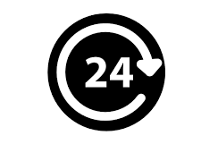
Operational risk – CMS proposal
CMS proposes a compliance and complaints indicators
An index for both compliance and complaints will be calculated for each scheme
The index scores will be translated into the amount of capital required (as a % of premiums)
?
It is inappropriate to hold reserves for operational risk
?
Unclear how a compliance score can be calibrated to a probability of ruin
?
Tick box approach may not capture risk
?
Subjective
?
Complaints may be unfounded / in response to legitimate risk interventions

Slide 11
Asset risk – ITAP proposal
Elements of asset risk
  Unexpected loss in capital value and/or
  Unexpected decreases in income
Method of quantifying asset risk
  Assume the lowest annual return by asset class in the last 50 years
Asset Risk is the percentage of additional capital required to withstand a worst case decrease in all asset classes simultaneously
Notes:
11

Slide 12
Asset risk – ITAP proposal
Example values could be:
  Cash default risk assumed 0.03%
  Property lowest return of -10.1%
  Bonds: -17.7%
  Equities: -25.8%
These values are only illustrative
Asset classes may need to be divided further e.g. government vs. corporate bonds
Notes:
12

Slide 13
Asset risk – ITAP proposal
Free Assets
Assets to cover liabilities
Total assets
Asset risk capital should only apply to assets held to cover liabilities
Assets above liabilities are deemed free assets
Free assets could be invested less conservatively to allow for greater returns

Slide 14

Asset risk – CMS proposal
CMS proposes asset risk must protect against extreme market events
Extreme markets events are defined as the maximum loss (over a certain time period) for each asset class
The asset risk is calculated as the weighted sum of the maximum loss for each asset class, where the weights are the distribution of assets by class
?
Assumes asset classes are 100% correlated
?
Asset risk classes are too broad (also applies to ITAP model)
?
Risk capital requirements unresponsive to market cycles (also applies to ITAP model)

Slide 15
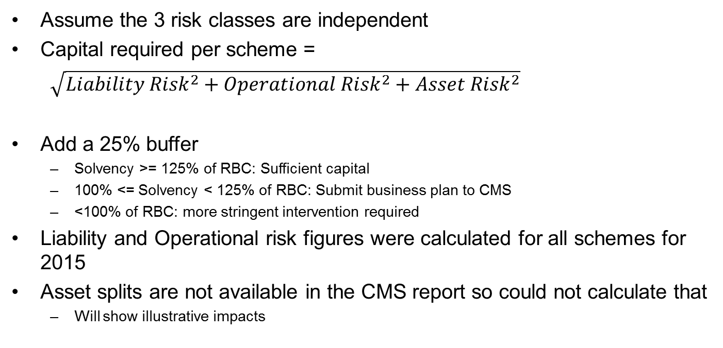
RBC formula – ITAP proposal
Assume the 3 risk classes are independent
Capital required per scheme =
$\sqrt{{Liability Risk}^{2}+{Operational Risk}^{2}+{Asset Risk}^{2}}$
Add a 25% buffer
  Solvency >= 125% of RBC: Sufficient capital
  100% <= Solvency < 125% of RBC: Submit business plan to CMS
  <100% of RBC: more stringent intervention required
Liability and Operational risk figures were calculated for all schemes for 2015
Asset splits are not available in the CMS report so could not calculate that
  Will show illustrative impacts
Notes:
15

Slide 16
Results – ITAP proposal
Notes:
16

Slide 17
Results – ITAP proposal
After taking out the schemes that subsequently amalgamated:
 | <100% of RBC | <125% of RBC | Number of schemes
Open | 6 | 7 | 22
Restricted | 9 | 12 | 60
Total | 15 | 19 | 82
5 of the 15 schemes were below 25% in 2015 and would have had to build solvency anyway
The others have had consistently large operating deficits
Very few schemes are thus negatively impacted compared to their 2015 position
Notes:
17

Slide 18
Impact of Asset Risk – ITAP proposal
Example 1: Asset split as follows:
  Cash: 65%
  Property: 5%
  Bonds: 20%
  Equities: 10%
  Asset risk term = 6.6%
  If Total risk (excluding asset risk) was 30%, this would increase to 30.7%
Example 2: Asset split as follows:
  Cash: 30%
  Property: 10%
  Bonds: 30%
  Equities: 30%
  Asset risk term = 14.1%
  If Total risk (excluding asset risk) was 30%, this would increase to 33.1%
The more risky the asset mix, the greater the required solvency
Notes:
18

Slide 19
Pricing for an operating deficit
The formula will penalise a scheme for pricing for operating deficits
RBC increases by more than the recent deficit
Example 1:
  Scheme has had only operating surpluses
  Operational risk of 3%
  Financial risk of 16.6%
  Total risk (excluding asset risk) is thus: 16.9%
Example 2:
  Same scheme but with an operating deficit of 5% of contributions in prior year
  Financial risk increases to 24.1%
  Total risk (excluding asset risk) is now: 24.2%
Example 3:
  Same scheme as Example 1 but with an operating deficit of 5% of contributions in prior 2 years
  Financial risk increases to 29.1%
  Total risk (excluding asset risk) is now: 29.3%
Notes:
19

Slide 20
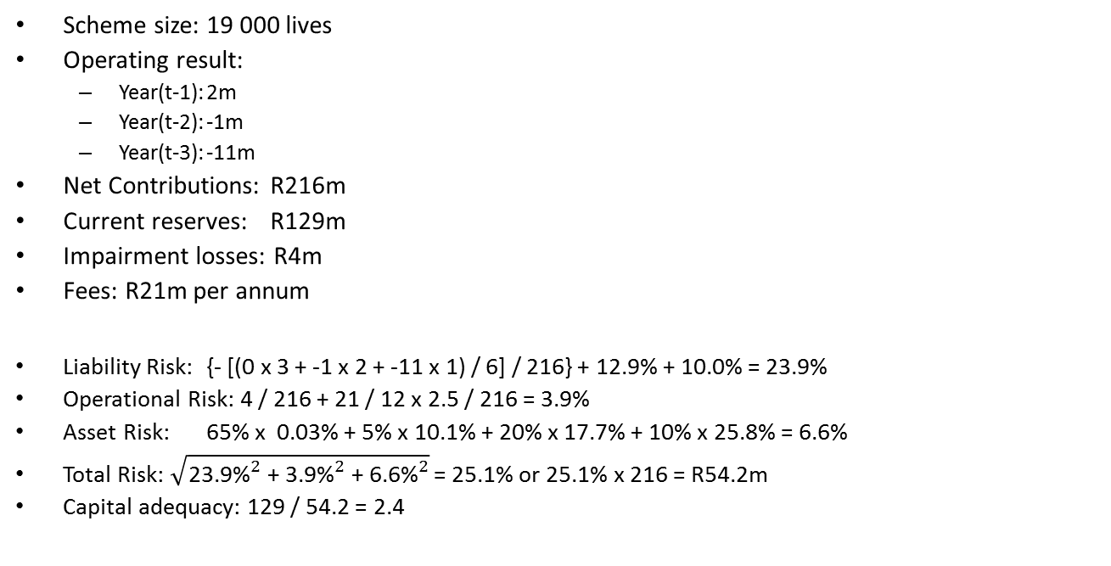
Example 1 – ITAP proposal
Scheme size: 19 000 lives
Operating result:
  Year(t-1): 2m
  Year(t-2): -1m
  Year(t-3): -11m
Net Contributions: R216m
Current reserves: R129m
Impairment losses: R4m
Fees: R21m per annum
Liability Risk: {- [(0 x 3 + -1 x 2 + -11 x 1) / 6] / 216} + 12.9% + 10.0% = 23.9%
Operational Risk: 4 / 216 + 21 / 12 x 2.5 / 216 = 3.9%
Asset Risk: 65% x 0.03% + 5% x 10.1% + 20% x 17.7% + 10% x 25.8% = 6.6%
Total Risk: $\sqrt{{\text{23.9\%}}^{2}\text{ + }{\text{3.9\%}}^{2}\text{ + }{\text{6.6}\text{\%}}^{2}}$ = 25.1% or 25.1% x 216 = R54.2m
Capital adequacy: 129 / 54.2 = 2.4
Cash: 65%
Property: 5%
Bonds: 20%
Equities: 10%

Slide 21
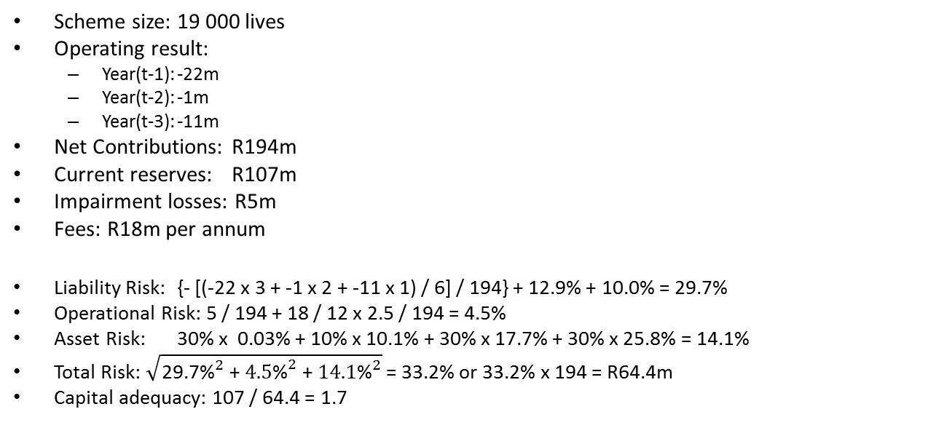
Example 2 – ITAP proposal
Scheme size: 19 000 lives
Operating result:
  Year(t-1): -22m
  Year(t-2): -1m
  Year(t-3): -11m
Net Contributions: R194m
Current reserves: R107m
Impairment losses: R5m
Fees: R18m per annum
Liability Risk: {- [(-22 x 3 + -1 x 2 + -11 x 1) / 6] / 194} + 12.9% + 10.0% = 29.7%
Operational Risk: 5 / 194 + 18 / 12 x 2.5 / 194 = 4.5%
Asset Risk: 30% x 0.03% + 10% x 10.1% + 30% x 17.7% + 30% x 25.8% = 14.1%
Total Risk: $\sqrt{{\text{29.7}\text{\%}}^{2}\text{ + }{\text{4.5}\text{\%}}^{2}\text{ + }{\text{14.1}\text{\%}}^{2}}$ = 33.2% or 33.2% x 194 = R64.4m
Capital adequacy: 107 / 64.4 = 1.7
Cash: 30%
Property: 10%
Bonds: 30%
Equities: 30%

Slide 22
Conclusion ITAP model
Some further work required to refine ITAP proposal
ITAP model relatively simple to establish to allow a move to an RBC approach
Very few schemes negatively impacted
  In most cases solvency for impacted schemes are below the required levels currently
Accumulated funds at an industry level unlikely to reduce as RBC requirements increase if a scheme prices for an operating loss
  Member security will thus not decrease
Contribution increases can be lower as schemes can price for lower but more appropriate solvency levels
Schemes are able to reduce their solvency requirements by managing their risks better
Notes:
22

Slide 23
Closing remarks on the CMS model
The industry welcomes the initiative by the CMS to review the current solvency framework
The industry appreciates that the CMS recognizes the shortcomings of the current solvency framework and the impact of these shortcomings on the sustainability of medical schemes
The discussion document published by the CMS in November 2015 recognizes that the process of determining adequate capital requirements is multi-faceted with a myriad of factors that must be considered to efficiently protect schemes against their individual risks
The industry appreciates the CMS’s collaborative stance, and stakeholders are looking forward to working with the CMS to determine the best RBC framework for the industry

